Slide 1

Module 2.2 Network basics

Slide 2
Contents
Small networks – a PAN and a HAN
Personal area network
Home area network
What is needed to connect?
Setting up a small network
Connecting to the internet
Test and improve
Written module activity

Slide 3
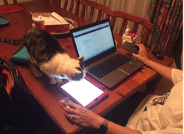
Small networks – a PAN and a HAN
Personal area network
A network organised around an individual or a couple of individuals with a range of a few metres
Main purpose and advantage:
To automate connections between mobile devices
Disadvantages:
Limited range
Data transmission can be slow
Peripheral devices usually only pair with one computing device at a time

Slide 4
Small networks – a PAN and a HAN
Home area network
A small network within a home environment that connects devices such as computers, printers, tablets, smartphones, smart TVs and gaming devices
Main advantages:
Users can access and share their data from any computing device in the home
Users can save money by sharing devices such as a printer
An internet connection can be shared by all the computing devices in the home
Security can be an issue with wireless networks
Address using passwords etc.

Slide 5
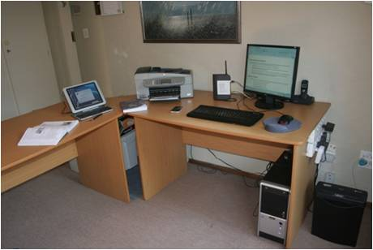
What is needed to connect?
Setting up a small network
Hardware
Computing devices themselves
Hardware that can be shared (e.g. printers)
Switch: connects computers with cables
Router: allows devices to connect to the internet
Most routers today include a built-in switch

Slide 6
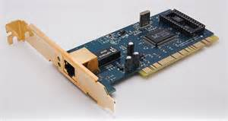
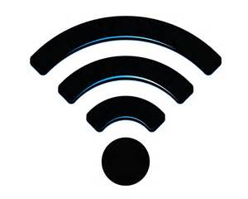
What is needed to connect?
Setting up a small network
Connection methods: wirelessly or with cables
Every computing device must
either be wireless-enabled
or have a NIC (Network Interface Controller)
PAN: Bluetooth most common means of connecting devices
HAN: Both wireless and wired connection methods are used

Slide 7
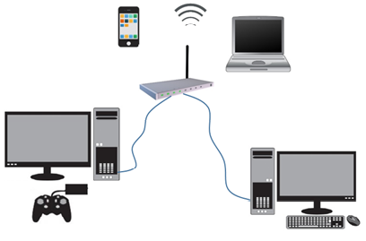
What is needed to connect?
Setting up a small network
Connection methods – cont.
Wired connection
UTP (Unshielded Twisted Pair) cable
One end plugs into port (NIC) of computer, other into switch / router
Wireless connection
WiFi access point is needed (usually built into router)
Devices – wireless-enabled, use radio waves for connectivity
WiFi = wireless network technology that uses radio waves to provide network access, small area

Slide 8
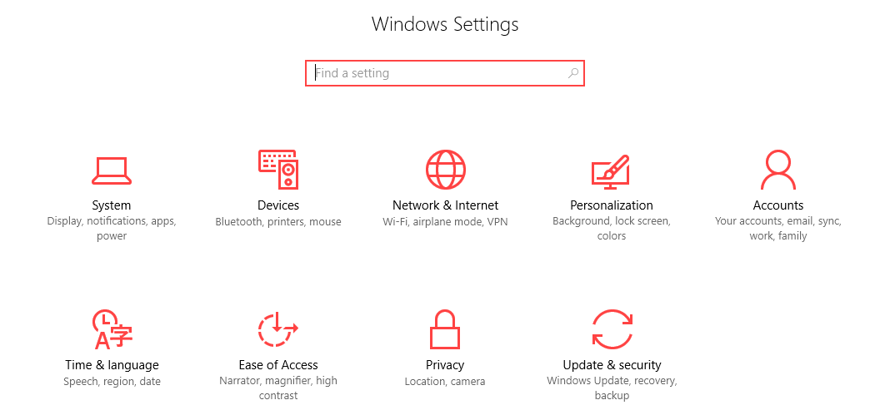
What is needed to connect?
Setting up a small network
Software
Used to control security and communication in the network
Built into operating system software of the computing device

Slide 9

What is needed to connect?
Connecting to the internet
Internet
Large worldwide computer network, consisting of computers and networks linked using communication media
Every device that connects to the internet must have its own IP address
To connect a device to the internet, you need:
Internet Service Provider
Internet connection

Slide 10





What is needed to connect?
Connecting to the internet
Internet Service Provider
A company that has a permanent, fast connection to the internet
ISPs sell internet access and services to individuals and companies for a monthly fee

Slide 11
What is needed to connect?
Connecting to the internet
Internet Connection
Wired connection ADSL / Fibre
ADSL: permanent digital connection using a telephone line
Wireless connection Cellular technology
No need for ADSL / fibre
Fibre: data transmitted using thin glass fibre tubes (much faster!)
Allows mobile access
3G / 4G (LTE)
Dongle plugs into USB port – connects device to cellular network

Slide 12
Test and Improve
Summary – concepts, terms and tips
PAN
HAN
Hardware needed
Connection methods
Connecting to the internet

Slide 13
Written module activity

